Slide 1
IMPLEMENTATION OF DIGITAL TECHNOLOGIES IN ALUMINA REFINING: A PRODUCER EXPERIENCE
Vladimir Golubev
RUSAL Engineering & Research Center
Notes:
Enter speaker notes here.

Slide 2
About the Presenter
Vladimir Golubev, RUSAL Engineering & Research Center
Head of Mathematical Modeling Department,
PhD in metallurgy (2007),
18 years of experience, author of 6 books and >50 scientific papers.
Areas of Interests: simulation of process systems, CFD, machine learning, automation in alumina production.
List of co-authors: Dmitriy Mayorov, Evgeniy Fomichev, Dmitriy Chistyakov, Iliya Blednykh
No conflict of interest to declare
E-mail: vladimir.golubev2@rusal.com
Notes:
Enter speaker notes here.

Slide 3
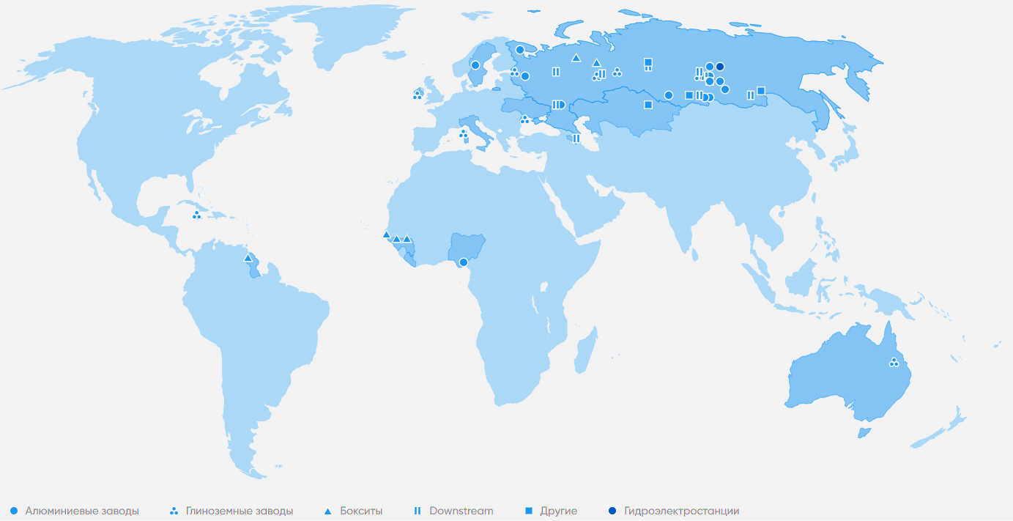
Purpose of Digital Technology Implementation
Reduction of production costs
Productivity increase
Improvement of management and decision-making procedures
Key figures for UC RUSAL for 2019:
7.86 million tons of alumina produced
3.76 million tons of aluminum produced
43 refineries operate on 5 continents
> 90% of energy comes from renewable sources
<4 tons of CO2 equivalent emissions per ton of Al
Reduction of harmful emissions
Notes:
Enter speaker notes here.

Slide 4
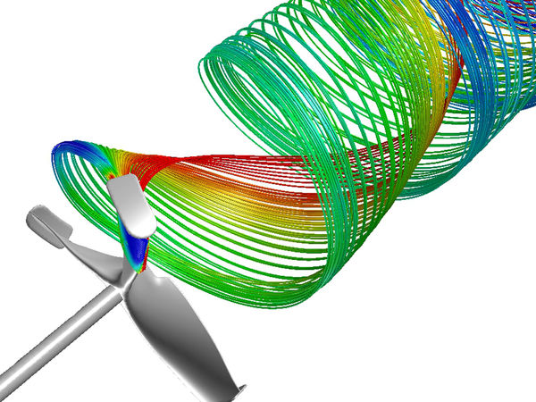
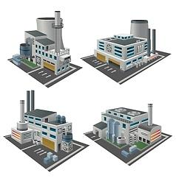
Digital Technologies in Simulation of Processes at Alumina Refineries
Traditional Digital twins
CFD
Machine learning
Equipment optimization using fluid dynamics
Simulation and optimization of alumina refineries
Statistical models and advanced control
Notes:
Enter speaker notes here.

Slide 5
Computational Fluid Dynamics
Gas / Liquid
Gas / Solids
Liquid / Solids
Multiphase flows and processes
prevail in alumina production
Boiling / Condensation
Combustion
Erosion
Notes:
Enter speaker notes here.

Slide 6
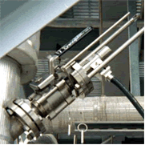
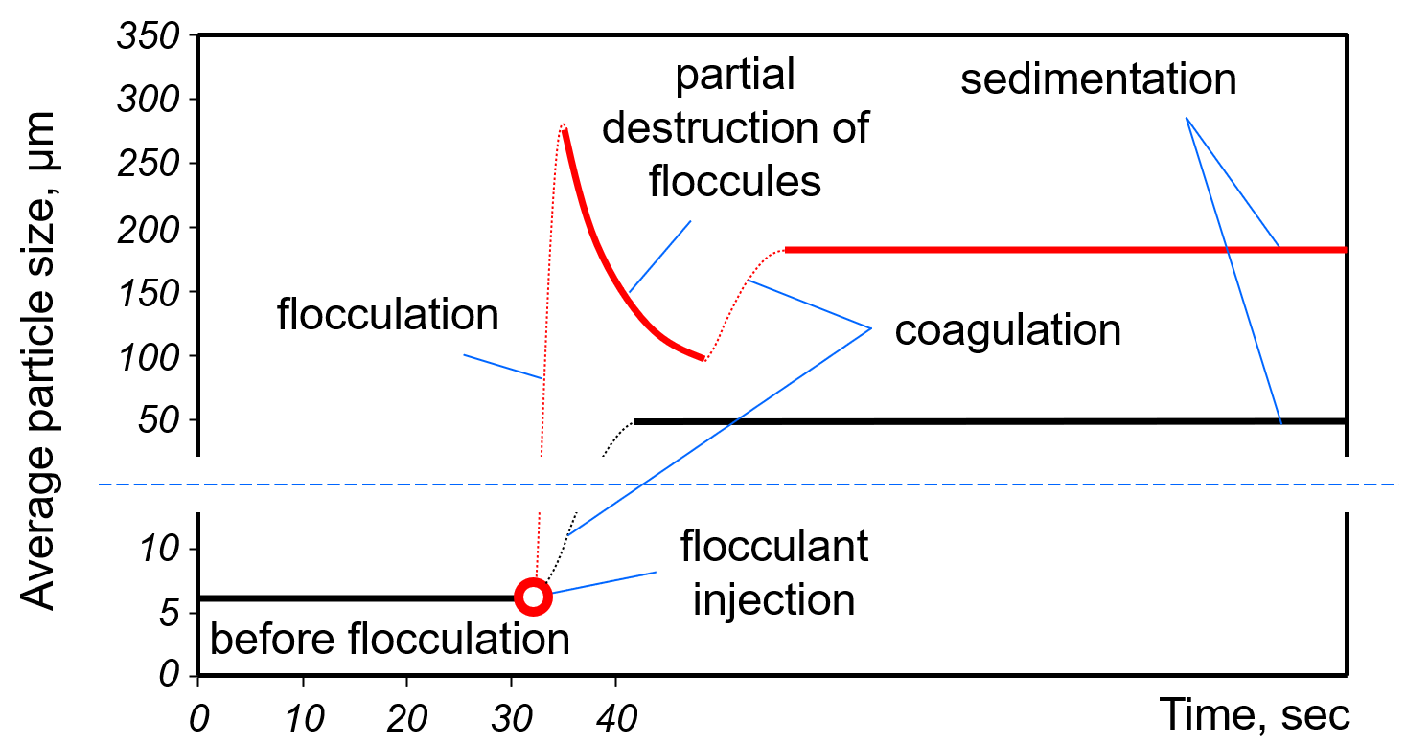
Thickening and Washing
Flocculation with FBRM control
Industrial implementations
Refinery | Slurry | Year | Result
UAZ | Bauxite residue | 2016 | Increasing capacity by 31%
AGK | Gray mud (belite) | 2018 | Reducing overflow solids by 30% Reducing flocculant dosage by 15%
BAZ | Soda slurry | 2020 | Reducing OF solids by 20%
Ewarton | Bauxite residue | 2020 | Increasing UF solids up by 27%
Dynamic simulation
of an industrial thickener
Notes:
Enter speaker notes here.

Slide 7
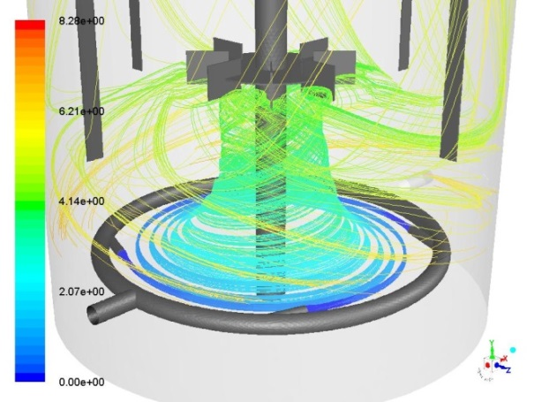
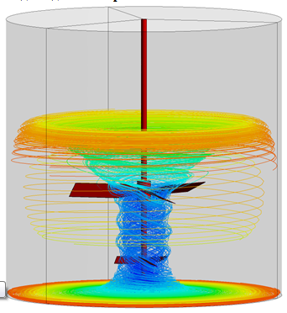
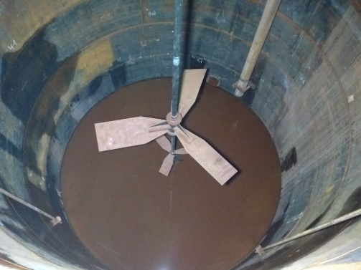
Agitation in Tanks
Mechanical mixing
Mixing with gas absorption
Air mixing
Industrial implementations
Refinery | Equipment | Year | Result
UAZ | Sc extraction unit | 2017 | 99-100% CO₂ absorption
BAZ | Bauxite slurry tank | 2019 | Reducing the cost of scale removing by 30%
UAZ | Precipitator | 2020 | Increasing useful volume by 3%
AGK | Feed tank | 2021 | Trials delayed
Mech. mixing and air injection
Notes:
Enter speaker notes here.

Slide 8
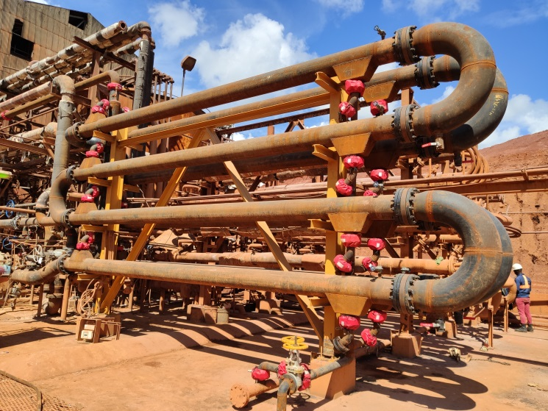
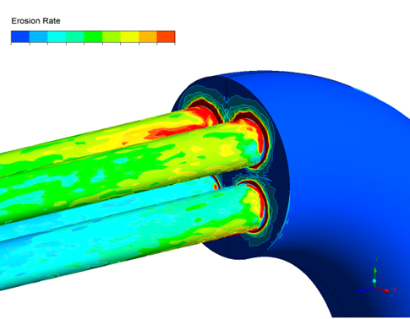
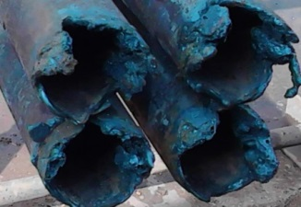
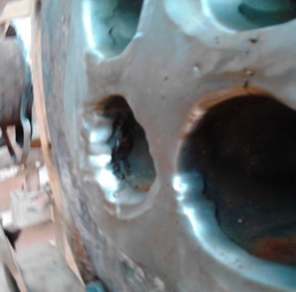
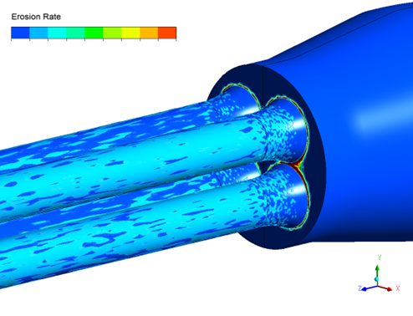
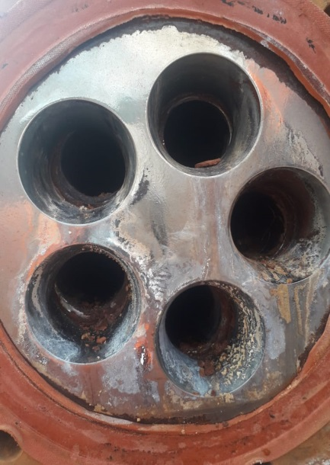
Abrasive and Cavitation Wear
Initial design
Industrial implementations
Refinery | Equipment | Year | Result
Ewarton | Indirect bauxite slurry preheater | 2020 | No signs of wear, Increasing caustic in digestion by 14 g/L
New design
Notes:
Enter speaker notes here.

Slide 9
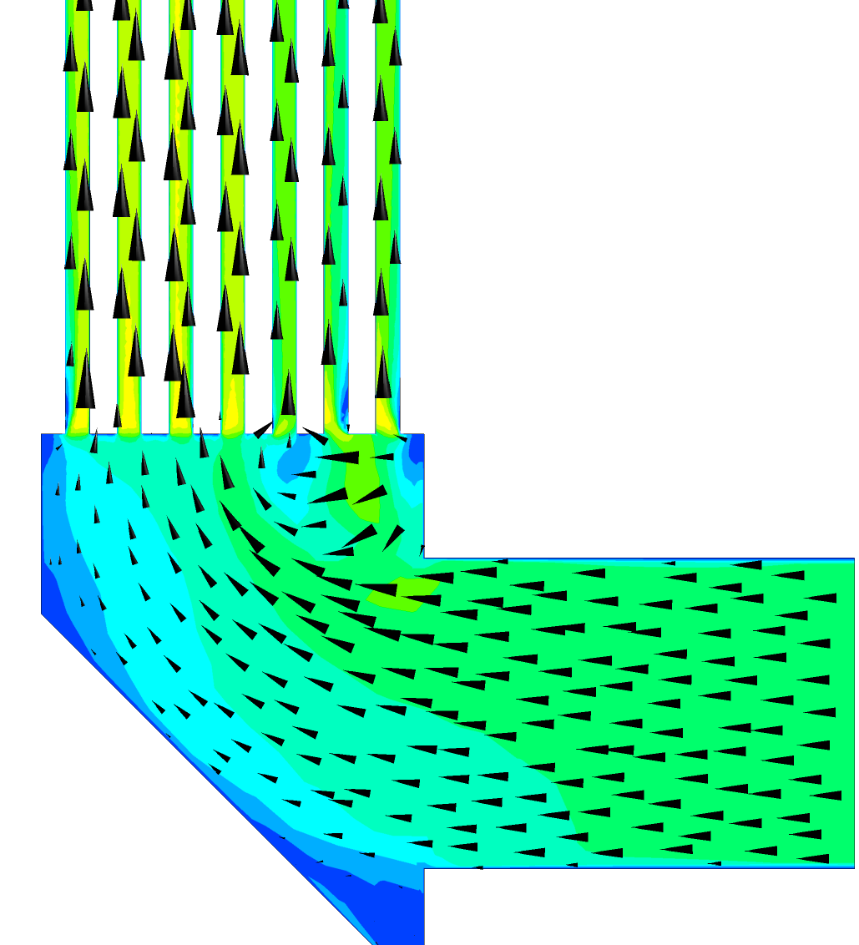
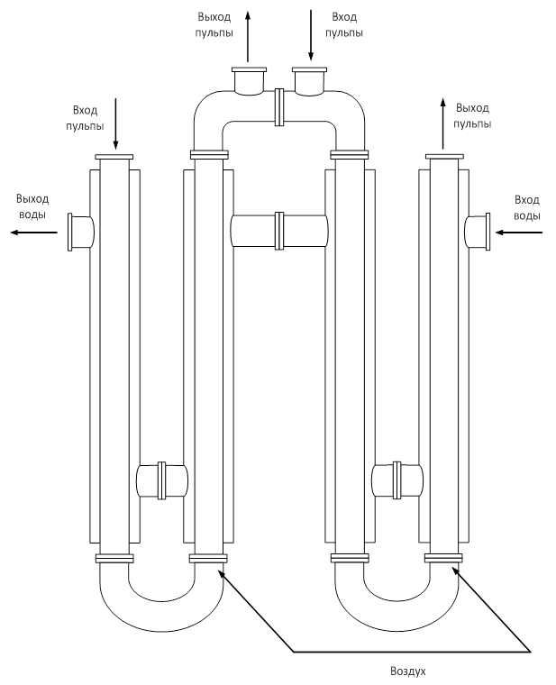
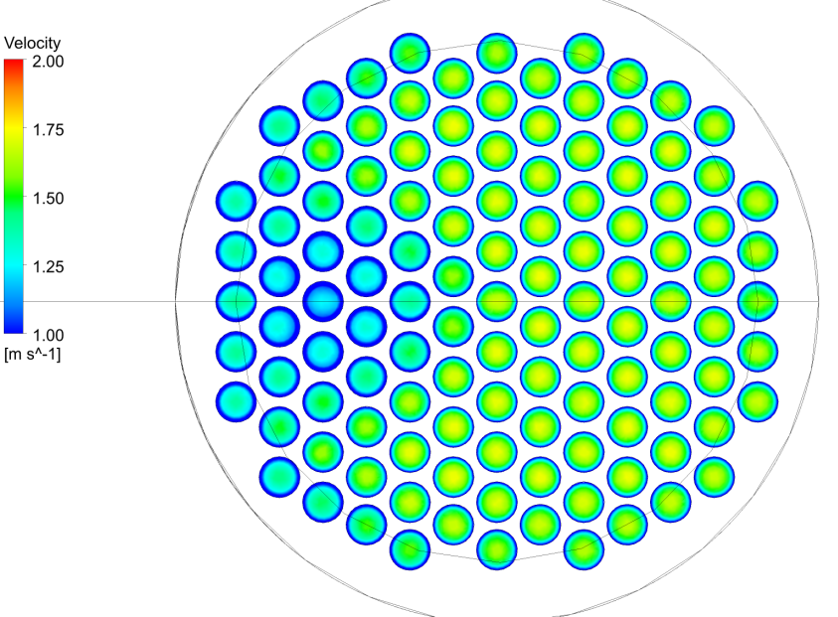
Incrustation of Heat Exchangers
Stagnant zone
Slurry
outlet
Slurry
inlet
Slurry
inlet
Slurry
outlet
Water
outlet
Water
inlet
Study of velocity pattern in the slurry cooler
Industrial implementations
Air
Pipe-in-pipe heat exchanger with airlift
Refinery | Equipment | Year | Result
BAZ | Slurry cooler in precipitation | 2021 | Trials are in progress

Slide 10
Calcination & Sintering
Temperature in the Flash Calciner
Burnout degree for different types of coal in the sintering kiln
Industrial implementations
Refinery | Equipment | Year | Result
AGK | Sintering rotary kiln | 2017 | Understanding changes in flame parameters when switching over from coal to brown coal
UAZ | Flash calciner | 2019 | Reducing fuel consumption by 2.4% (estimated)
Notes:
Enter speaker notes here.

Slide 11
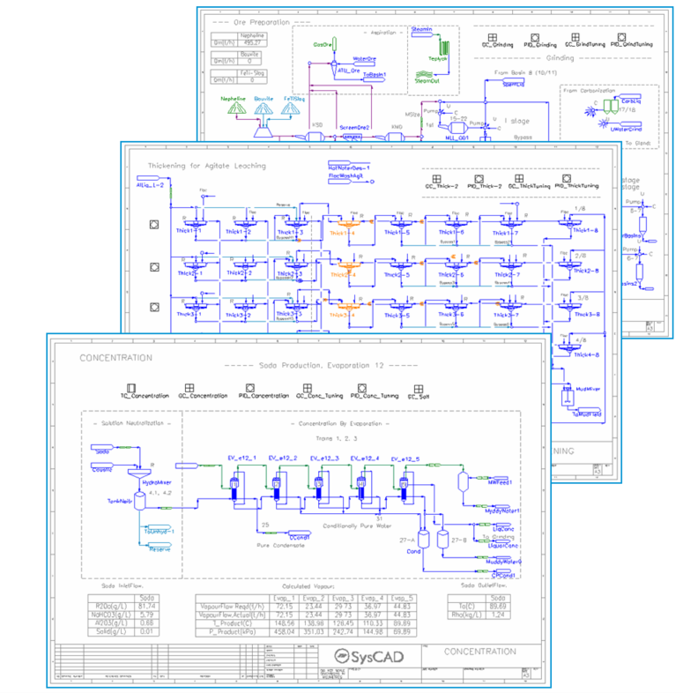
Traditional Digital Twins
Development goal:
the digital twin should respond to technology and equipment changes in the same way as a real facility
Pro/II
METSIM
Way to achieve the goal:
Simulation of process systems
UniSim
SysCAD was chosen by RUSAL as a platform for creating traditional digital twins
Notes:
Enter speaker notes here.

Slide 12
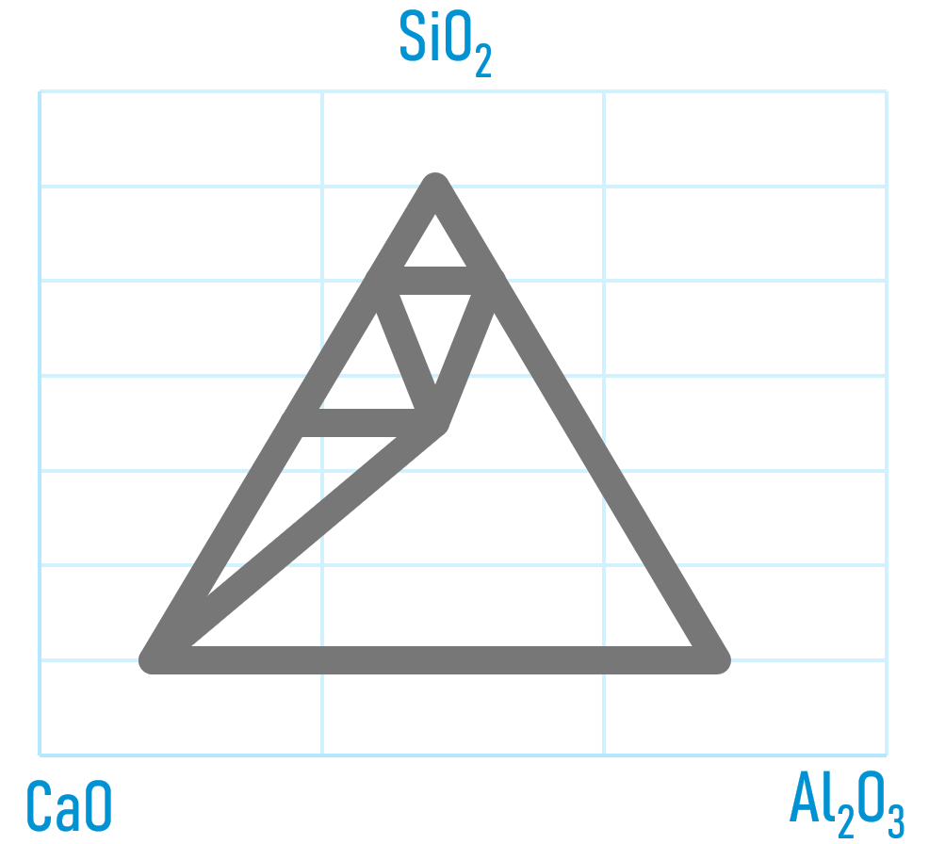
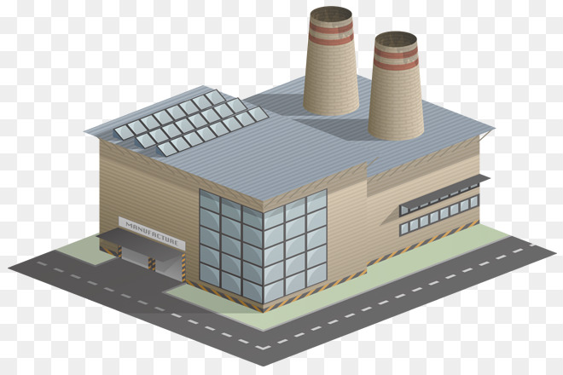
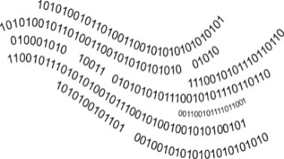
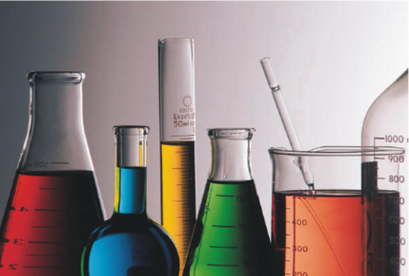
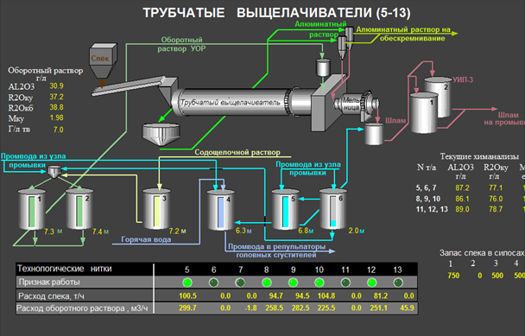
Development of a Digital Twin
Chemical data
Hardware specifications
Data Integration into code of Digital Twin
Laboratory research
Data from SCADA / MES
Notes:
Enter speaker notes here.

Slide 13
Digital Twin Applications
Sensitivity study | Determination of the enterprise's reaction to changes in any process indicator
Ongoing optimization | Search for the optimum in terms of cost, productivity when external conditions change and the internal constraints occur
Assessment of investment efficiency | Quantification of the effect on cost and productivity in ramp-up projects, release of new products, and local improvements
Business planning | Calculation of key process indicators for the next planning period
Industrial implementations at Russian Refineries
Refinery | Start | Side Effect in 2020, $/t Al₂O₃
UAZ | 2015 | 1.49
BAZ | 2017 | 0.77
AGK | 2020 | 1.10
Notes:
Enter speaker notes here.

Slide 14
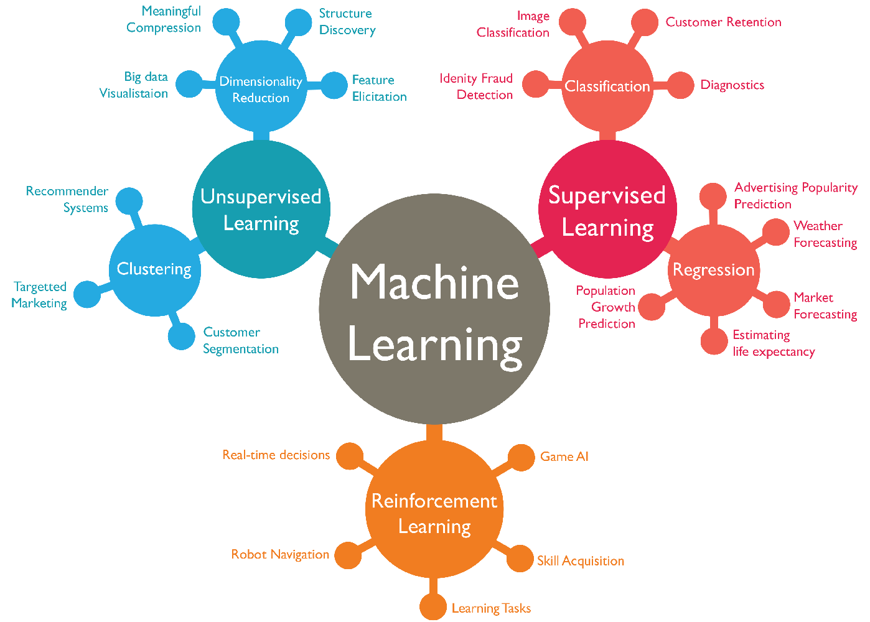
Machine Learning
Development goal:
creation of advisors for operators to simplify decision making and establish optimal process control
Ways to achieve the goal:
phenomenological models, machine learning,
hybrid models
Python, C#:
Scikit Learn, TensorFlow, Keras,
Self-developed mathematical and Bayer process libraries
Notes:
Enter speaker notes here.

Slide 15
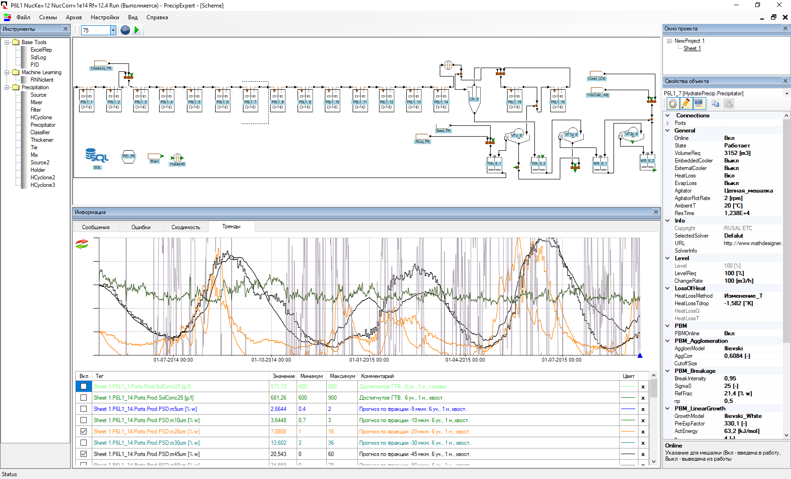
Traditional Model of Precipitation
Population Balance Model
with updated secondary nucleation and binary breakage equations (ICSOBA, 2020)
Model allows to explain and predict oscillations of PSD
but
preparation and execution of one calculation takes up to
2 hours of machine time
Actual -45 um, %
Predicted -45 um, %
Results of 1.5-year prediction: PSD, Liquor productivity, Nucleation rate, Number of particles.
Notes:
Enter speaker notes here.

Slide 16
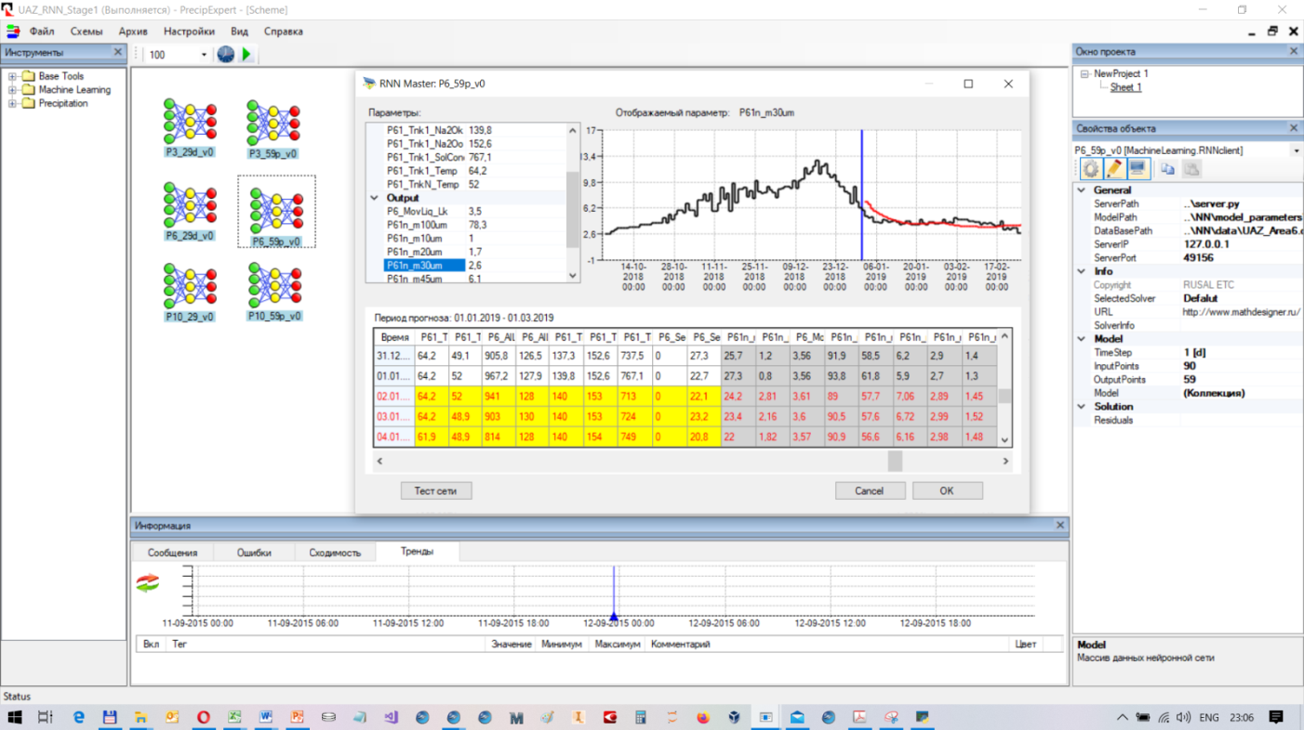
Deep Learning Model of Precipitation
Deep Neural Network
2 layers of LSTM + 1 layer of MLP,
about 50 000 trainable parameters
The model allows making new predictions of PSD and liquor productivity every 100 msec
In early 2021 correlation coefficient increased to 0.95
PrecipExpert – decision aid system for prediction of time-series in precipitation: hydrate PSD (all sizes) and liquor productivity
60-day forecast for the content of -45 µm seed (at this figure the average correlation coefficient is 0.93)
Notes:
Enter speaker notes here.

Slide 17
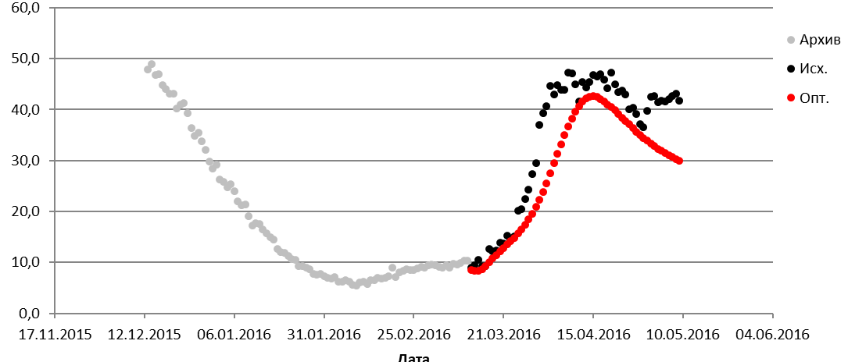
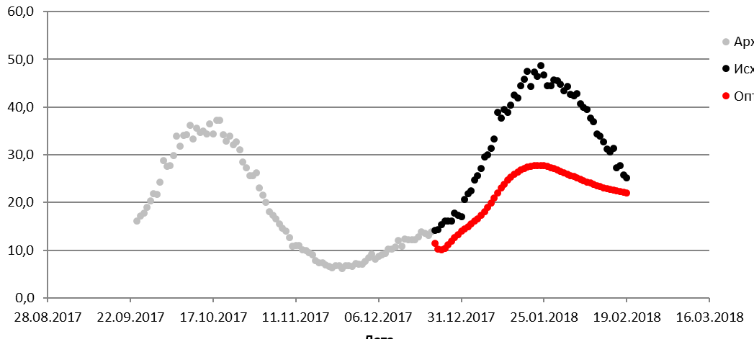
Optimal Control of Precipitation
Moment of forecasting
11th March 2016
Moment of forecasting
22nd December 2017
Historical
Optimal
Historical
Optimal
Content of -45 um in PSD, %
Content of -45 um in PSD, %
Date
Date
Process restrictions |  |  | Results of optimization
Liquor flow | Average solids, g/L | Productivity of refinery | Content of -45 um | Average Lk of Spent liquor | Chemical Yield, %
1336 | 758 | 90,3 | 28,6 | 0,29 | 50,5
Effect: |  |  | -6,0 |  | +3,3
Process restrictions |  |  | Results of optimization
Liquor flow | Average solids, g/L | Productivity of refinery | Content of -45 um | Average Lk of Spent liquor | Chemical Yield, %
1712 | 711 | 117,9 | 21,7 | 0,29 | 51,4
Effect: |  |  | -12,1 |  | -1,2
Study of optimal regimes of overcoming the historical periods of too fine hydrate
Notes:
Enter speaker notes here.

Slide 18
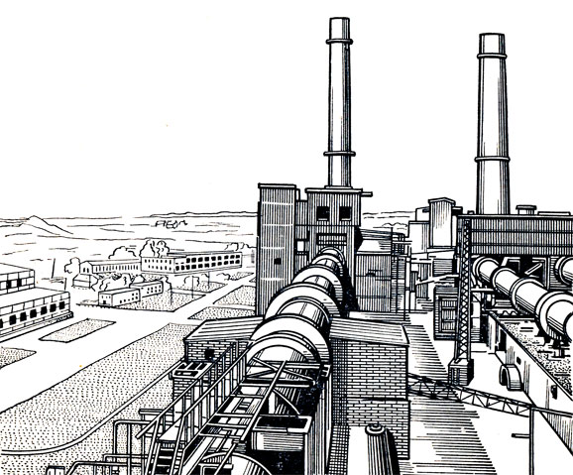
Online Refinery Optimization
Deep Neural Network
Absolute stability
Automatic solution
Constant calculation time
Smartphone or PC is enough
Computing time:
- one iteration – sec / msec
- optimal search – minutes
Traditional Digital Twin
Unstable solution
Manual control
Unpredictable calculation time
Cloud or cluster computing
Computing time:
- one iteration – hours
- optimal search – days or months
Faster
Cheaper
Simpler
Notes:
Enter speaker notes here.

Slide 19
Next Generation of Digital Twins
Computational Fluid Dynamics
Design Dependency
Reproducibility
Accurate & Complicity
Scalability
Quickness
Multivariable problems
Unknown dependences
Explainability
Traditional Digital Twins
Probability estimation
Machine Learning
Strict relations
Parametrical stability
Adaptivity
Data consistency
Data completeness
Data availability
Refinery
Notes:
Enter speaker notes here.

Slide 20
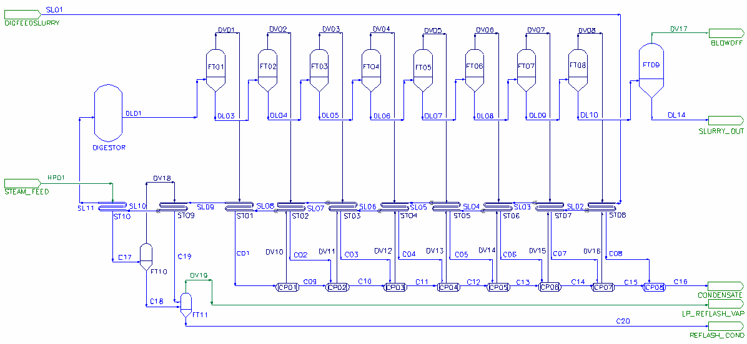
Adjusted Metal Balance
$$m_{Al}^{mes}=1005 kg,$$
$$m_{Al}^{mes}=122 kg,$$
Bauxite slurry
Digested Slurry. Liquor
$$m_{Al}^{adj}=95 kg$$
$$m_{Al}^{adj}=13 kg$$
Spent liquor
$$m_{Al}^{mes}=602 kg,$$
$$m_{Al}^{mes}=1403 kg,$$
Digested Slurry. Solids
$$m_{Al}^{adj}=59 kg$$
$$m_{Al}^{adj}=141 kg$$
Digestion
Optimization target
Al balance
$$F_{opt}=\sum_{i=1}^{n}{{\left(\frac{m_{i}^{mes}−m_{i}^{adj}}{∆x_{i}}\right)}^{2}}→min$$
Flow | Abs. error | Measured | Adjusted
Bauxite | ±5 | 100 | 95
Spent liquor | ±2 | 60 | 59
Slurry. Solids | ±2 | -12 | -13
Slurry. Liquor | ±3 | -140 | -141
Delta |  | 8 | 0
Material balance restriction
$$\sum_{i=1}^{n}{{sign}_{i}∙m_{i}^{adj}}=0$$
Notes:
Enter speaker notes here.

Slide 21
Adjusted Measurements
Optimization target
Digestion
Evaporation
$$F_{opt}=\sum_{i=1}^{n}{{\left(\frac{m_{i}^{mes}−m_{i}^{adj}}{∆x_{i}}\right)}^{2}}→min$$
Conditions and restrictions:
Al
Soda
Calcination
Heat
$$\sum_{i=1}^{n}{{sign}_{i}∙m_{i}^{adj}}=0$$
mass balance
Mud field
CHPP
energy balance
$$\sum_{i=1}^{n}{{sign}_{i}∙h_{i}^{adj}}=0$$
Advantages
Precipitation
improved measurement accuracy
elimination of redundancy of measurements
construction of smart sensor network
consistent balances of alumina, soda, impurities
sensors malfunction monitoring
and process knowledge, i.e. for precipitation:
$${∆Al}_{hydrate}=k_{0}\sum_{j=1}^{p}{{\left(\frac{A−A_{sat}}{C}\right)}^{2}exp\left(−\frac{E_{a}}{RT}\right)∙∆t}$$
Notes:
Enter speaker notes here.

Slide 22
ML and Nonlinear Approximation
$$\frac{∂u}{∂x_{1}}$$
$$x_{1}$$
_{Reverse Autodiff}
$$x_{2}$$
$$\frac{∂u}{∂x_{2}}$$
$PDE\left(u,x_{1},x_{2},x_{3},\frac{∂u}{∂x_{1}},\frac{∂u}{∂x_{2}},\frac{∂u}{∂x_{3}}\right)$=0
$$x_{3}$$
$$u$$
$$\frac{∂u}{∂x_{3}}$$
Principal of Approximation of PDE operator using a feedforward neural network
(https://pypi.org/project/fluidlearn/)
Notes:
Enter speaker notes here.

Slide 23
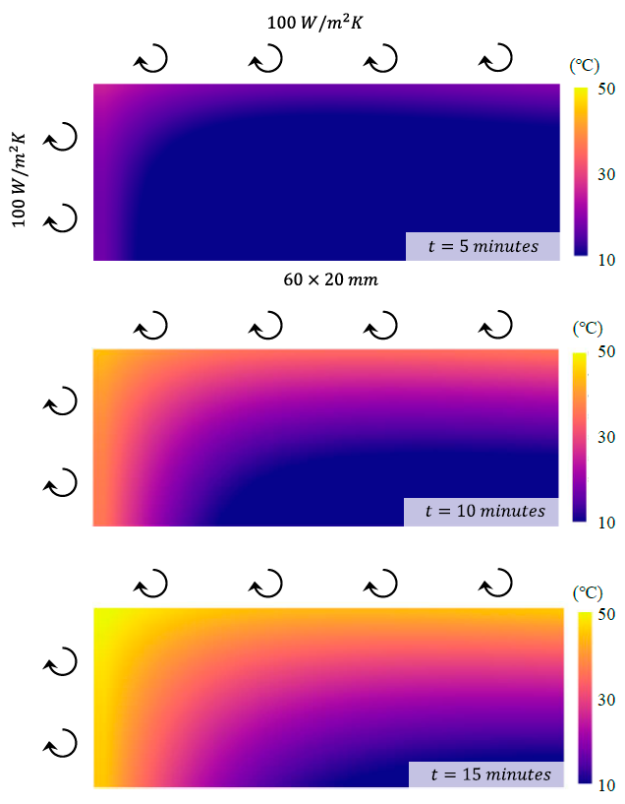
Solution of ODE and PDE by PINN
Literature references:
Physics-Constrained Machine Learning for Two-Phase Flow Simulation Using Deep Learning-Based Closure Relation
Chih-Wei Chang , Nam Dinh, and Sacit M. Cetiner, 2017
Physics Informed Deep Learning (Part I): Data-driven Solutions of Nonlinear Partial Differential Equations
Maziar Raissi, Paris Perdikaris, and George Em Karniadakis, 2018
Physics-informed machine learning approach for augmenting turbulence models: A comprehensive framework
Jin-Long Wu, Heng Xiao, and Eric Paterson, 2018
A Comprehensive Physics-Informed Machine Learning Framework for Predictive Turbulence Modeling
Jian-Xun Wanga , Jinlong Wua , Julia Lingb , Gianluca Iaccarinoc , Heng Xiaoa, 2018
Physics-informed machine learning for inorganic scintillator discovery
G. Pilania, K. J. McClellan, C. R. Stanek, and B. P. Uberuaga, 2018
A Physics-Informed Machine Learning Approach for Solving Heat Transfer Equation in Advanced Manufacturing and Engineering Applications
Navid Zobeiry, Keith D. Humfeld, 2020
An energy-based error bound of physics-informed neural network solutions in elasticity
Mengwu Guoa, Ehsan Haghighat, 2020
Real-time prediction of 2D time dependent heat transfer in solid plate by PINN (Navid Zobeiry, Keith D. Humfeld, 2018)
Notes:
Enter speaker notes here.

Slide 24
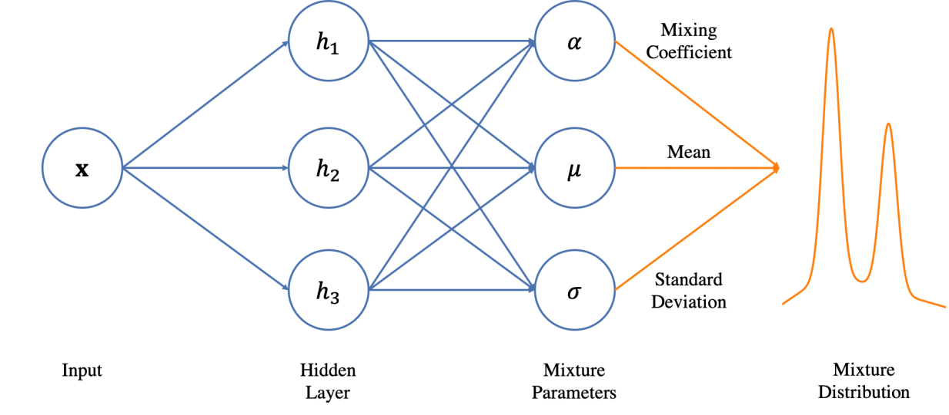
Mixed Density Network
Literature references:
Mixture Density Networks
Christopher M. Bishop, 1994
Regression with Probabilistic Layers in TensorFlow Probability
P. Sountsov, C. Suter, J. Burnim, J.V. Dillon, and the TensorFlow Probability team, 2019
Explainable and physics-informed machine learning for optimizing process chains and product quality
M. J. Neuer, D. Sonnenschein, H. Krambeer, M. Wunde, N. Holzknecht, M. Feldges, 2020
Combination of a deep neural network (DNN)
and a mixture of distributions
(Dr. Oliver Borchers. From data to business value: Data Science, 2019)
High precision prediction of scales on a rolled steel surface
(M. J. Neuer, D. Sonnenschein, H. Krambeer, M. Wunde, N. Holzknecht, M. Feldges, 2020)
(P. Sountsov, C. Suter, J. Burnim, J.V. Dillon, TensorFlow Prob. team, 2019)
Notes:
Enter speaker notes here.

Slide 25
Physics-Informed Machine Learning in Industrial Processes
Process Data
Consistent measurements
Available knowledge:
Production balance systems are used at alumina refineries
Approximation of nonlinear equations by neural networks has already been worked out
Algorithms for solving ODE and PDE by PIMM are available
Mixture Density Network (MDN regression) has been developed
There are examples of successful utilization of physics-informed machine learning models in industrial applications
+
Known parameters & relations
_{Physics-informed NN}
+
Noise & Disturbances
_{P}robability calculations
+
Unknown unknowns
_{Machine Learning}
Hybrid model will be stable while using industrial data, fast, scalable, adaptive, and capable for improvement
Notes:
Enter speaker notes here.

Slide 26
www.rusal.com/ https://allow.rusal.com/
Please contact us by e-mail: vladimir.golubev2@rusal.com

